Slide 1
Update Meeting
09.01.2025

Slide 2
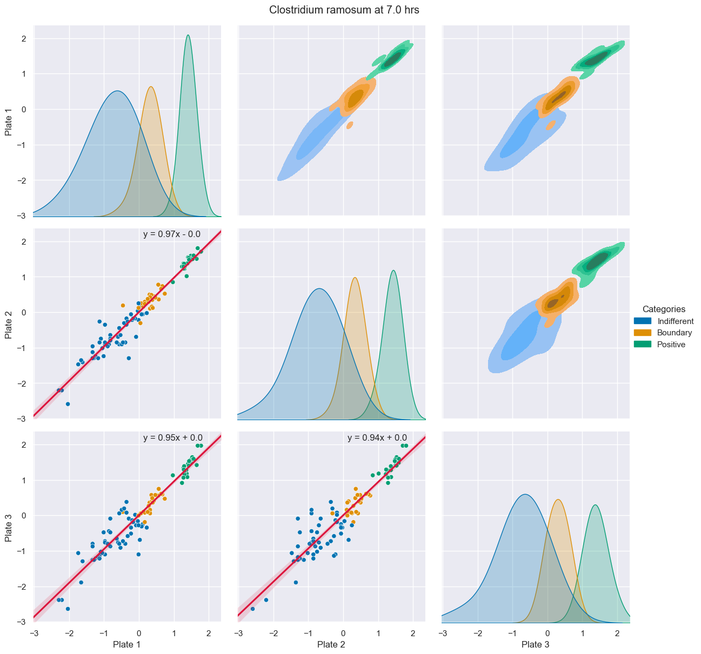
Diagonal
KDE (Kernel Density Plots)
Upper Corner
KDE bivariate
Levels : 5
Threshold : 10%
Lower Corner
Scatter Plot
Linear Regression Model Plot
Line
Formula
Confidence interval : 95%
Categorization
Average (Maja’s System)
Notes:
KDE (Kernel Density Estimate)
Method for visualizing distribution of data, analogous to histograms
Use a continuous probability density curve in one or more dimensions
Levels determine the contour counts of the drawn shape, they correspond to the iso-proportions of the density. E.g if the threshold is set to 10%, that amount of the probability mass will lie inside the drawn contour

Slide 3
General Points
Total of 132 PairGrids from 4 possible combinations:
BWA raw and normalized
Categorized with BIOLOG and BNT
Strains with the highest data range differences:
23-36 at 19 hrs → 321
23-33 at 48 hrs → 297
23-34 at 22 hrs → 294
23-32 at 168 hrs → 289
Things to analyse:
Plate correlation through BIOLOG categorization possible?
RegPlots’ slope differences
Data Groups’ Distributions and Densities
Data Sets’ Shape

Slide 4
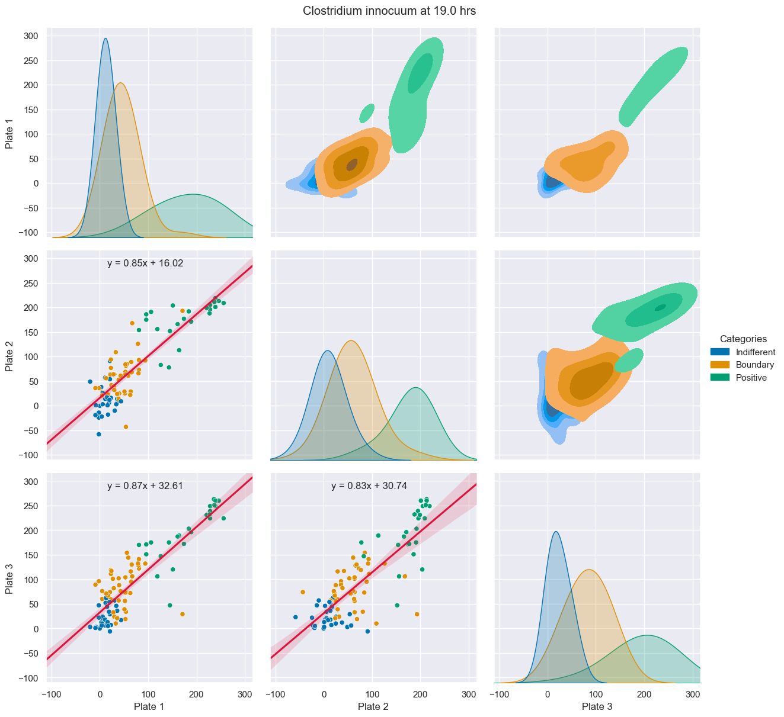
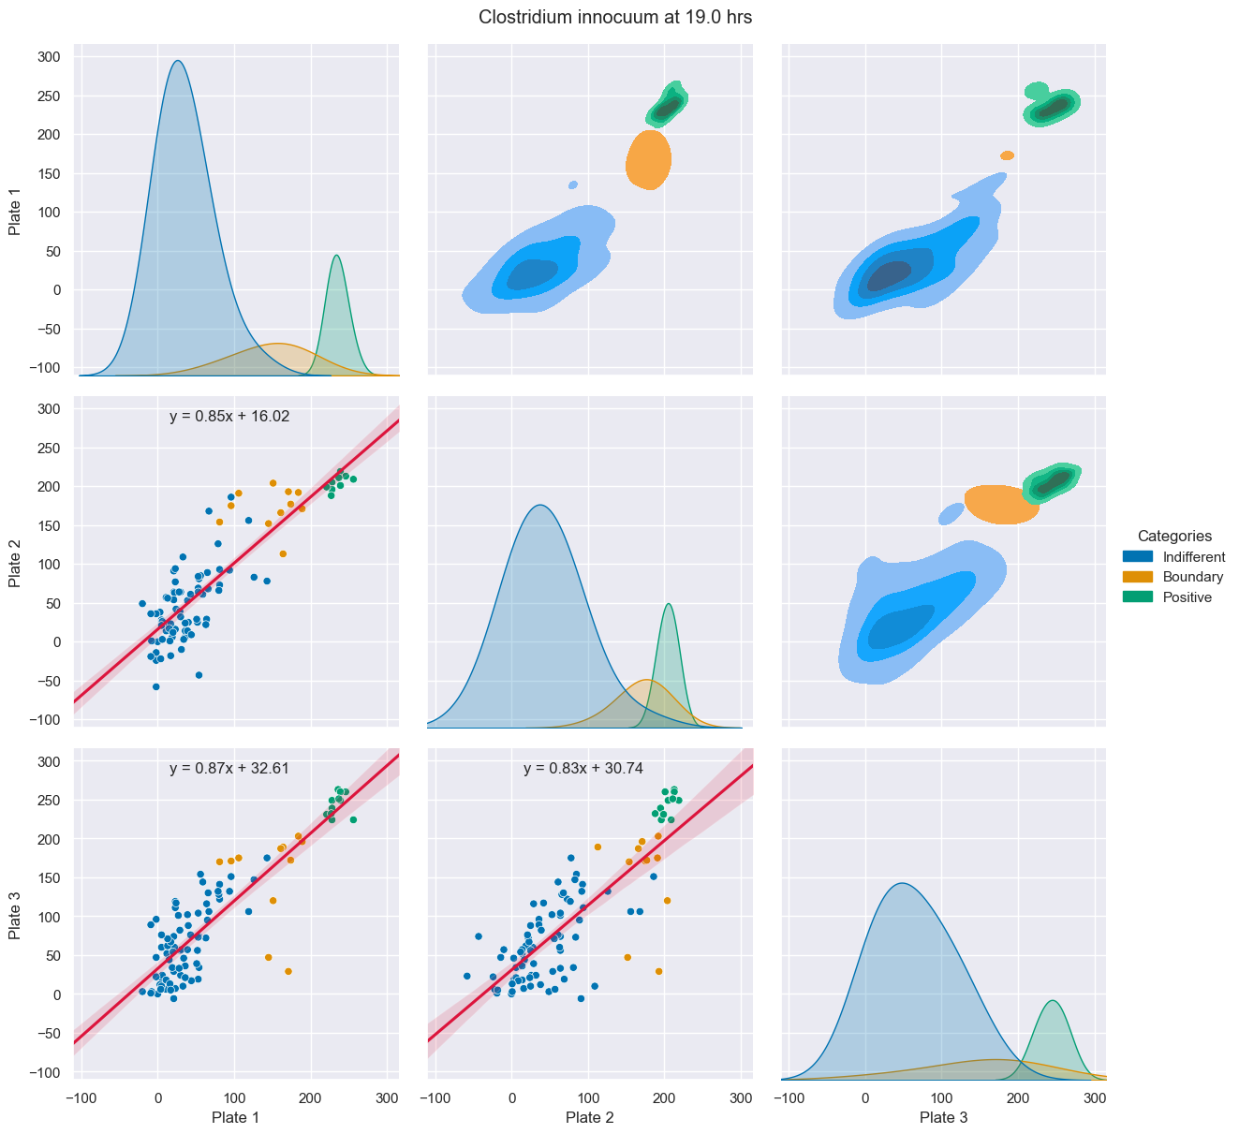
23-36 BWA Raw
BIOLOG
BNT

Slide 5
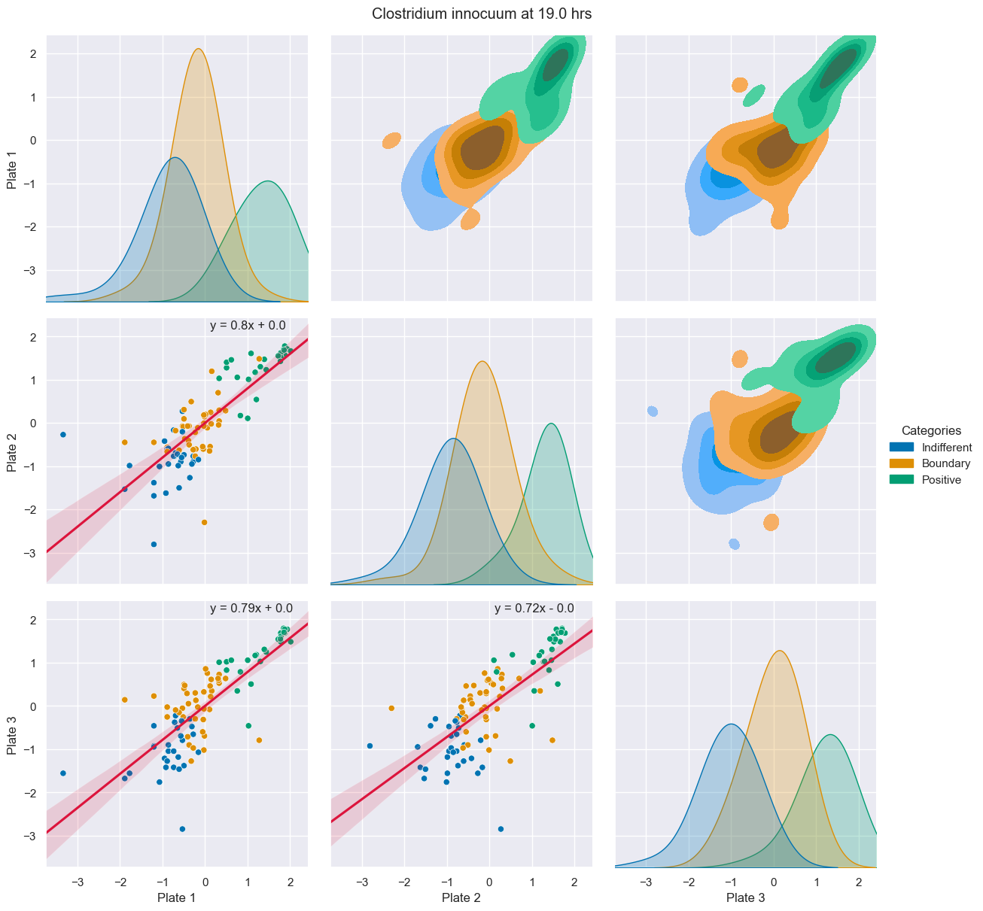
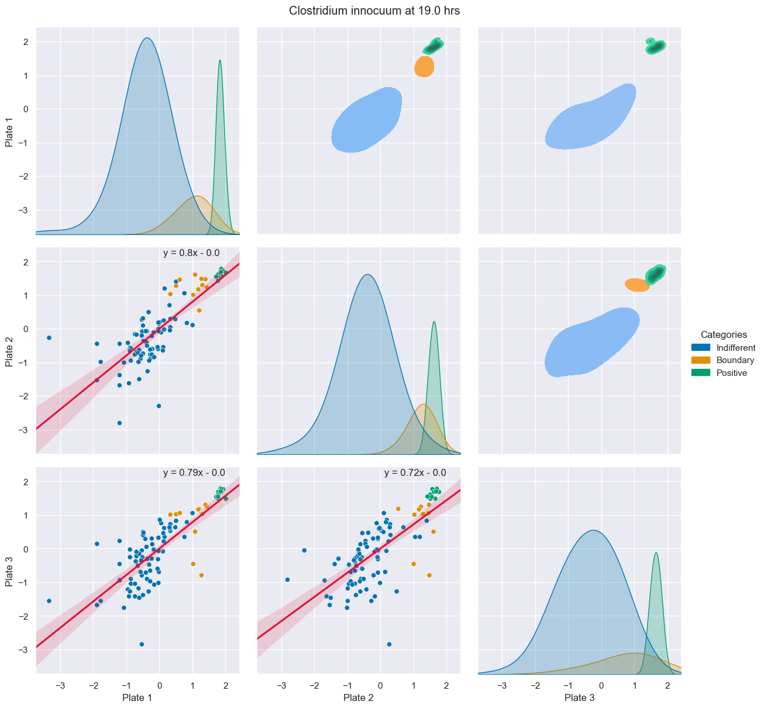
23-36 BWA Normalized
BIOLOG
BNT
Notes:
- Outliers influence regplot

Slide 6
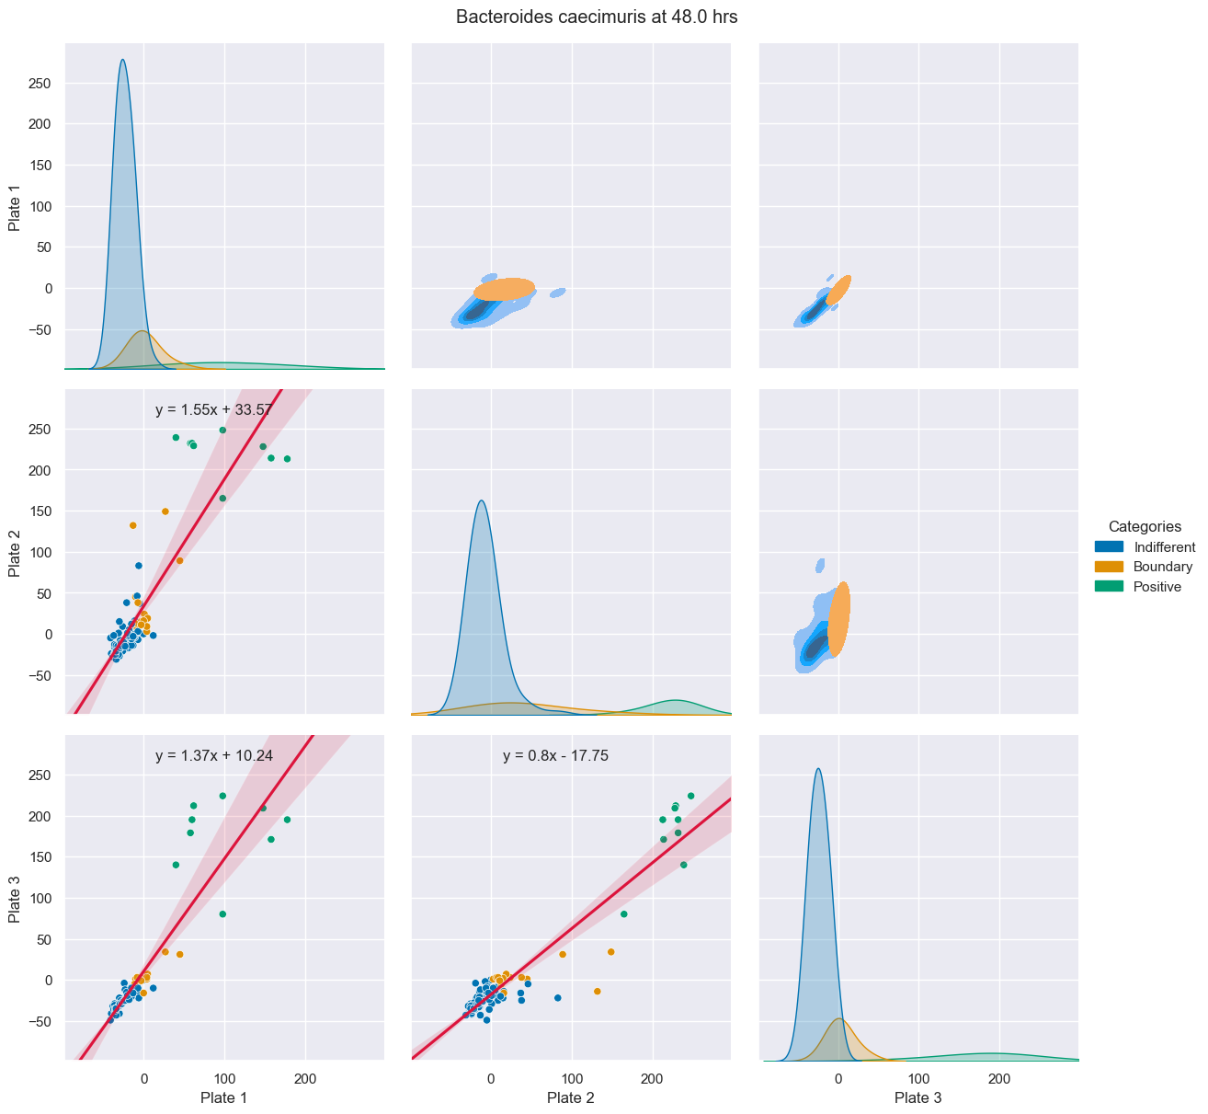
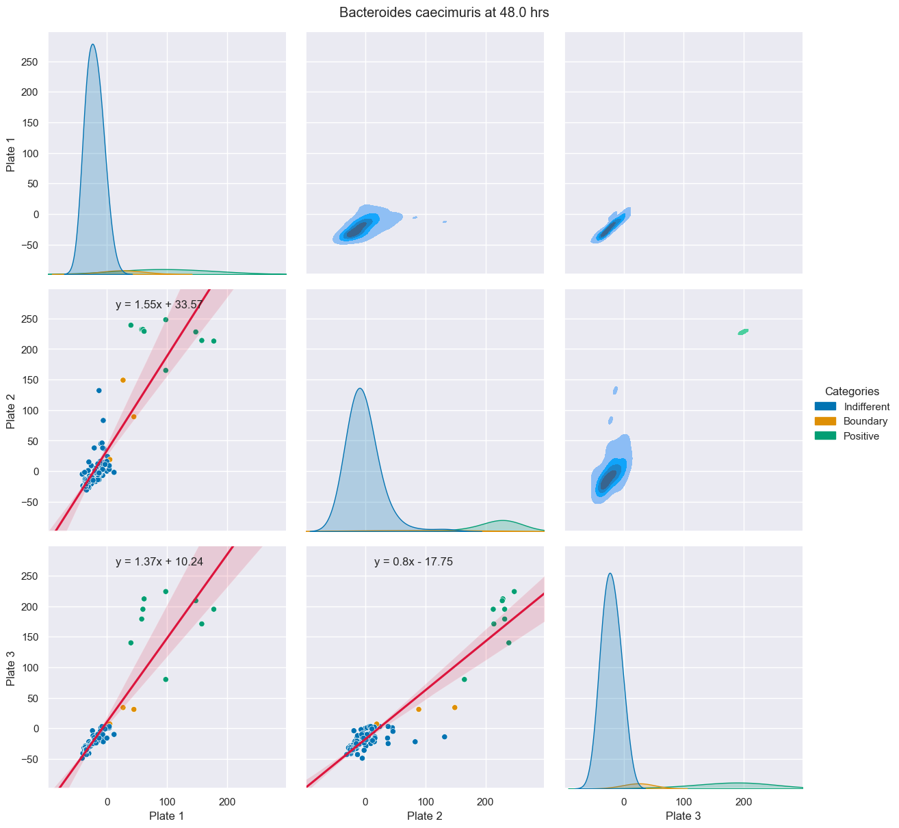
23-33 BWA Raw
BIOLOG
BNT

Slide 7
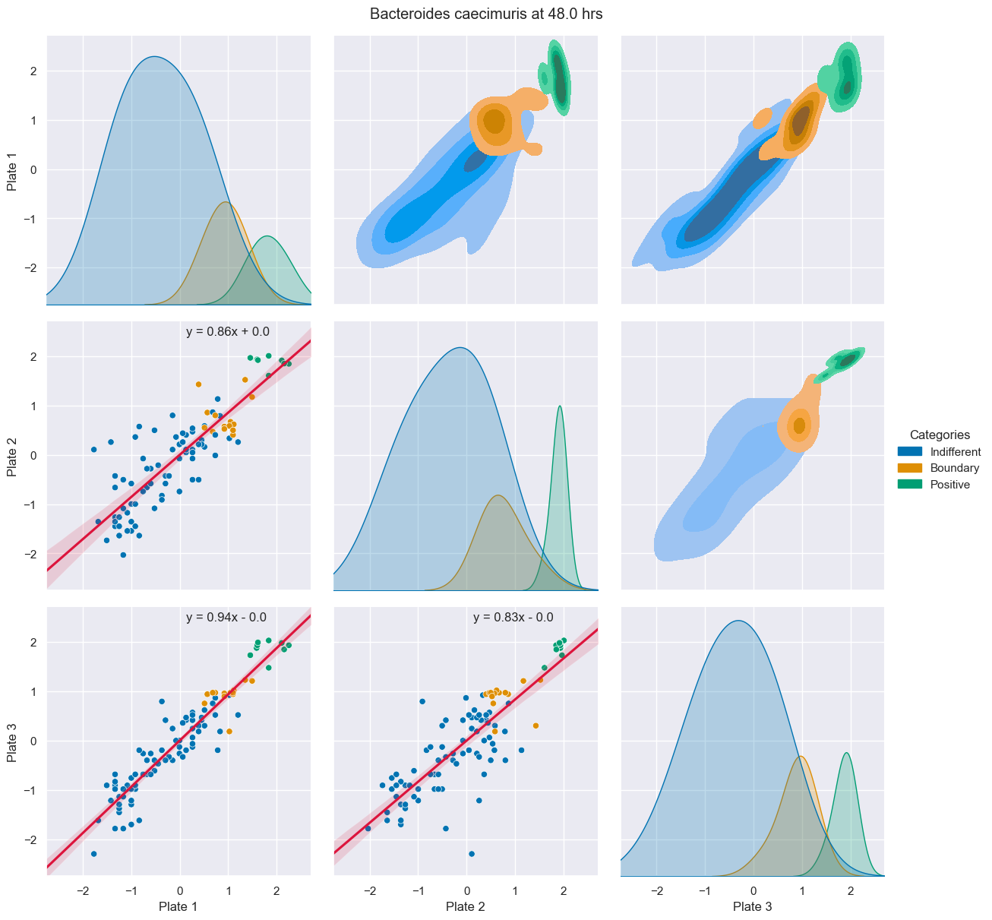
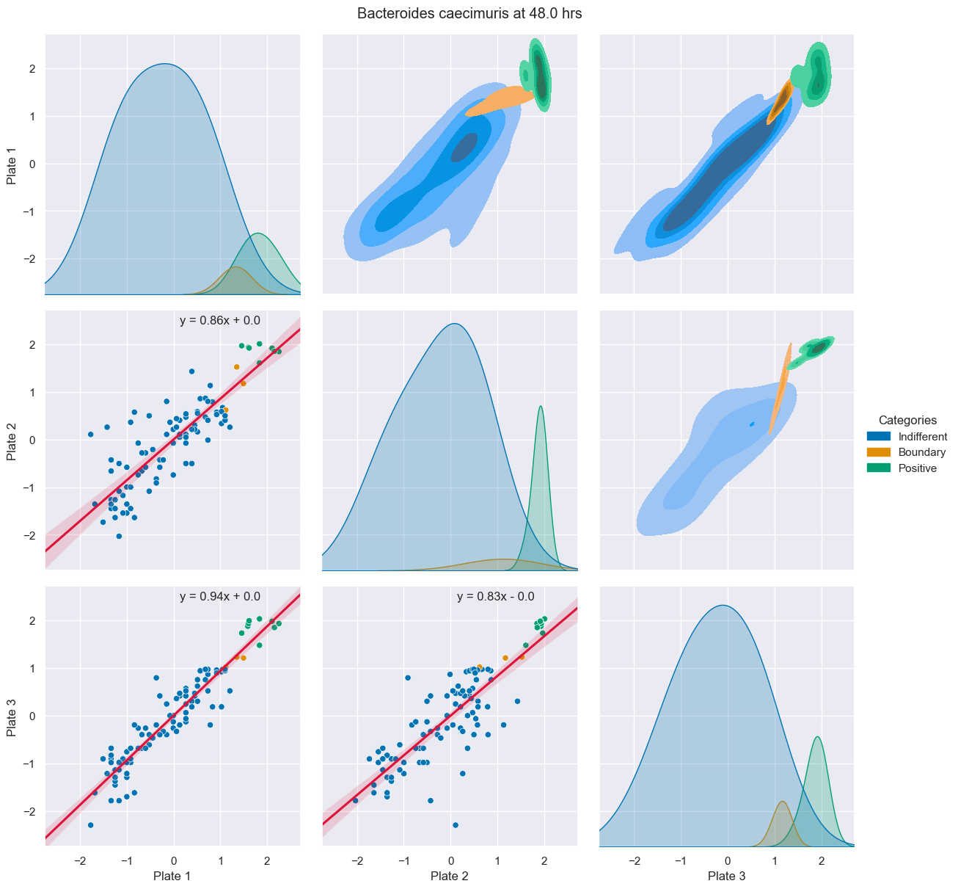
23-33 BWA Normalized
BIOLOG
BNT
Notes:
- Significant distance between negative / boundary groups to positive causes spread in the normalized data

Slide 8
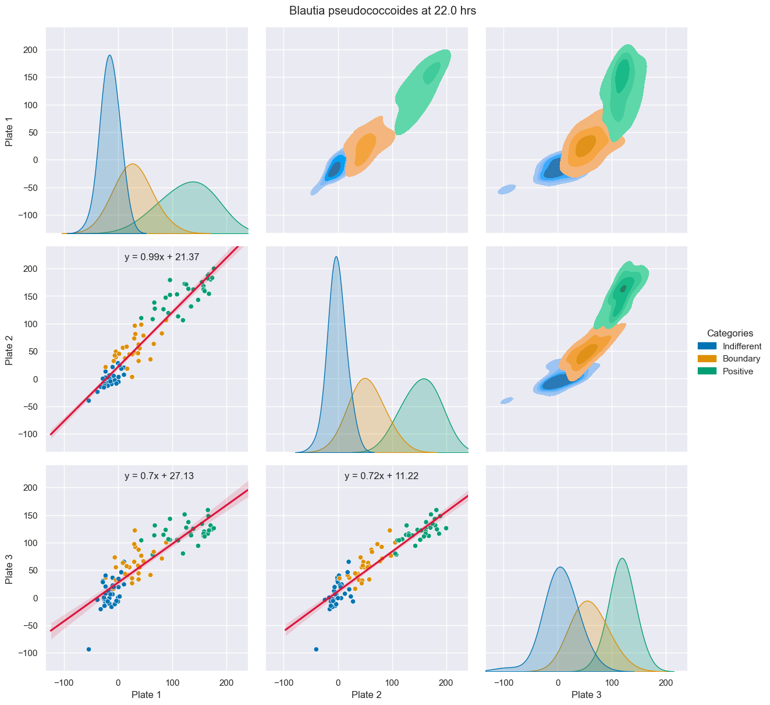
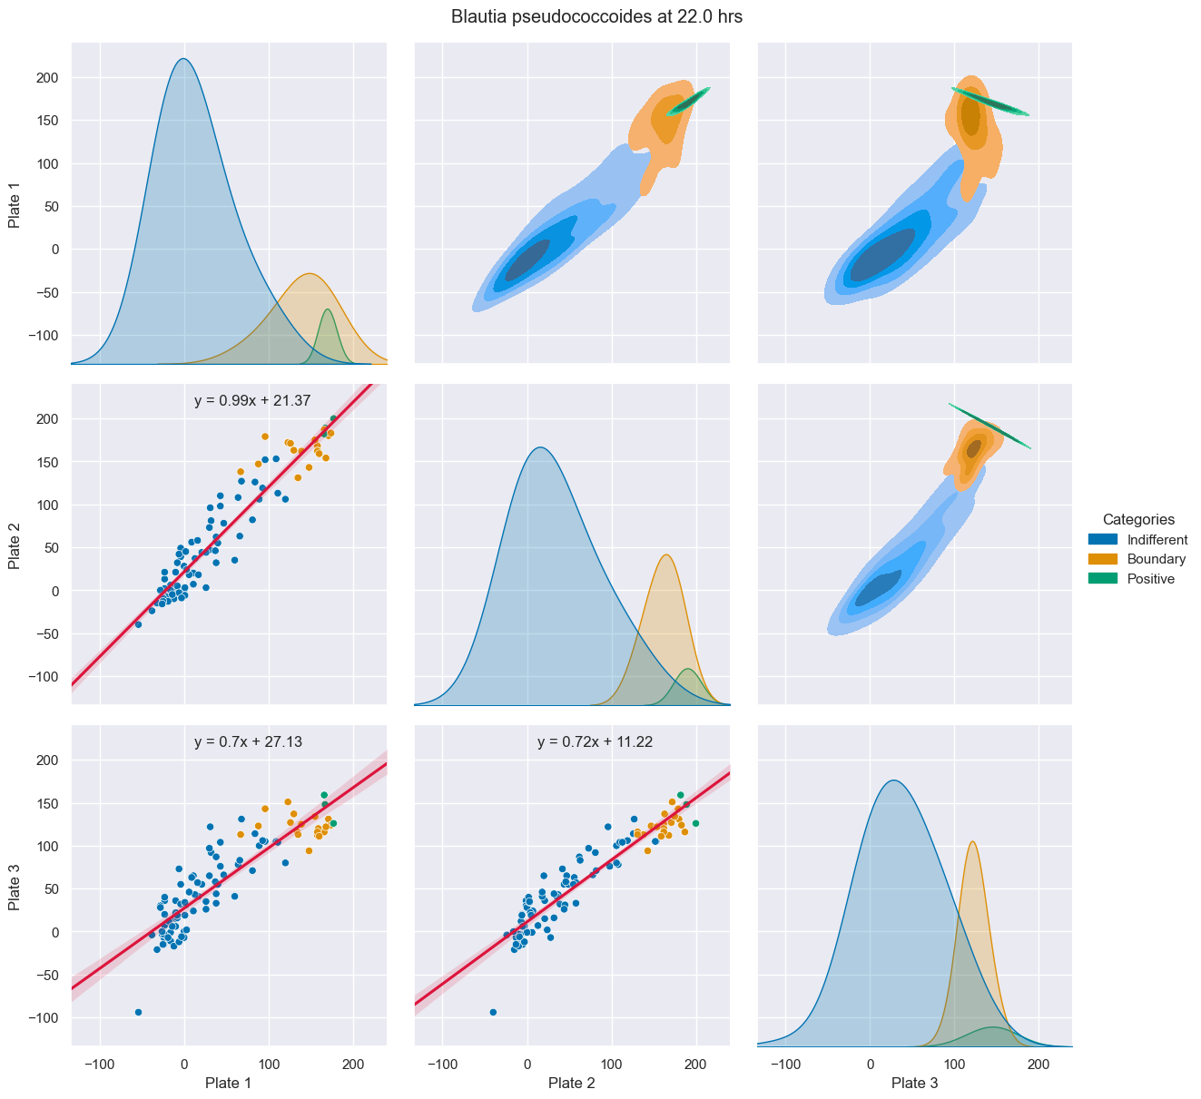
23-34 BWA Raw
BIOLOG
BNT

Slide 9
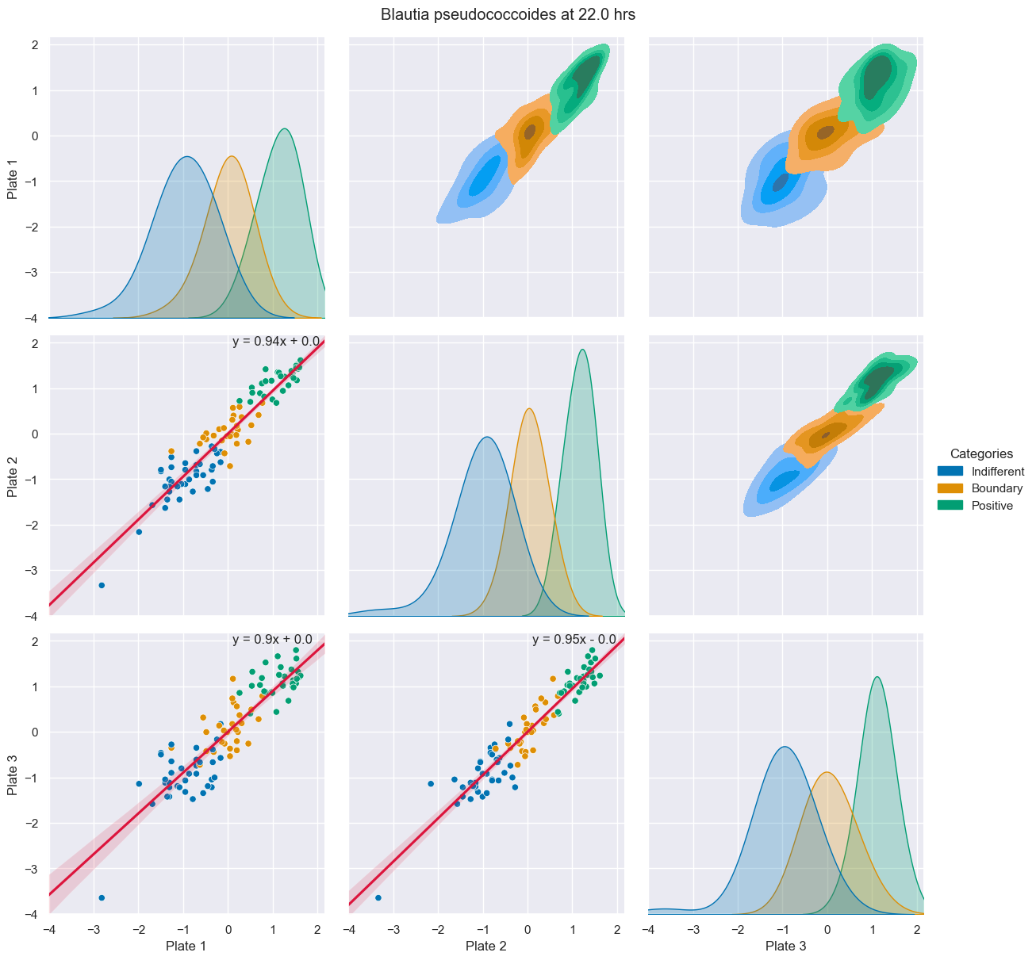
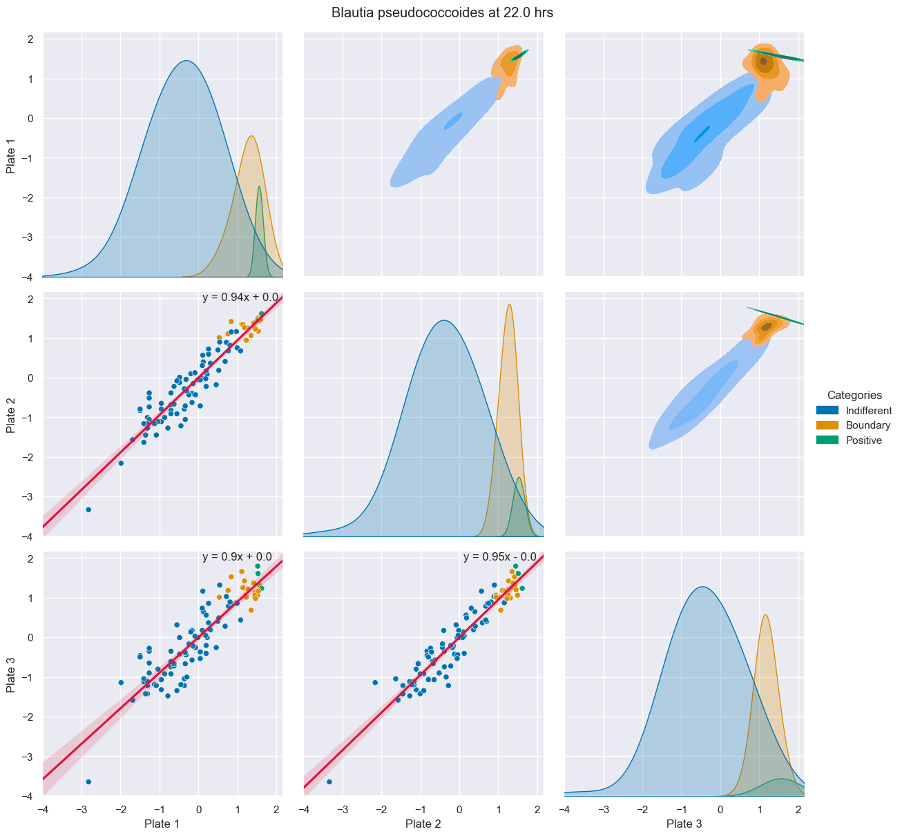
23-34 BWA Normalized
BIOLOG
BNT

Slide 10
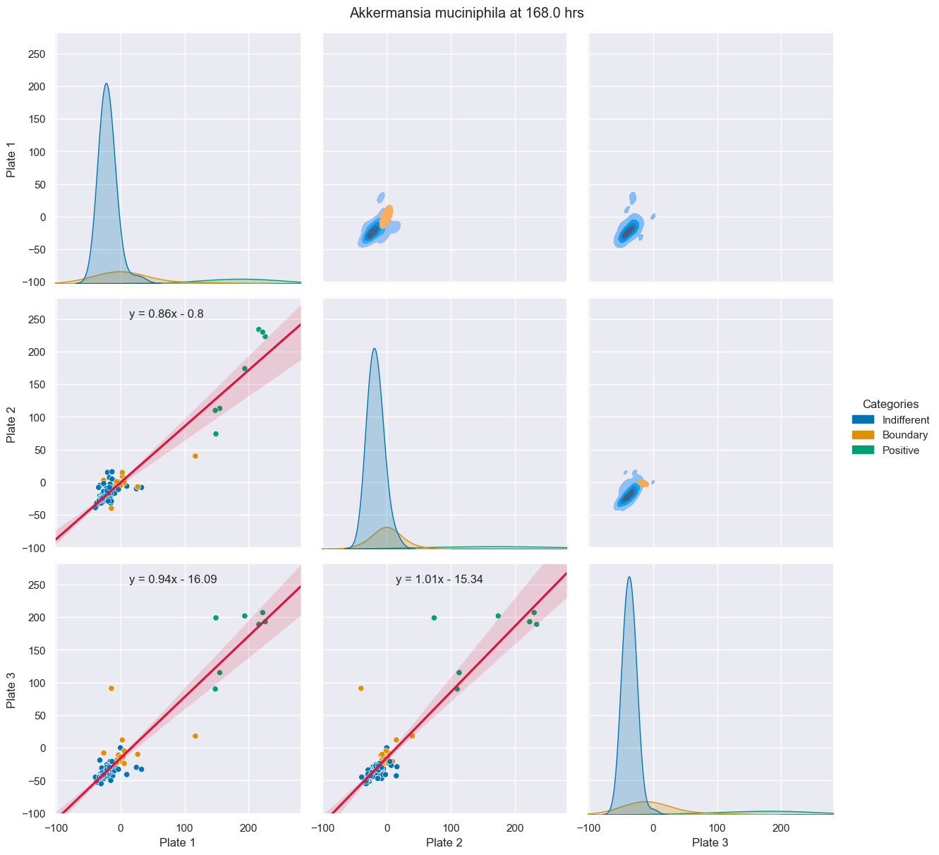
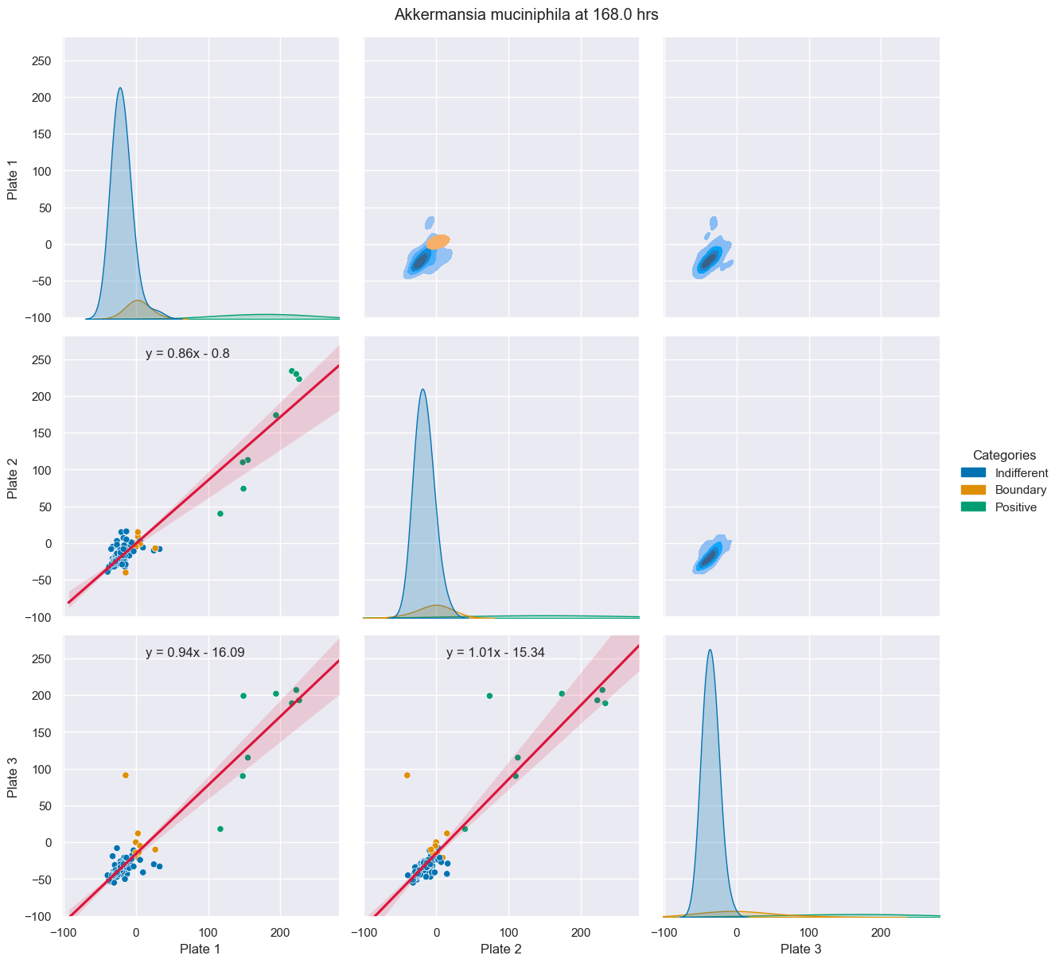
23-32 BWA Raw
BIOLOG
BNT

Slide 11
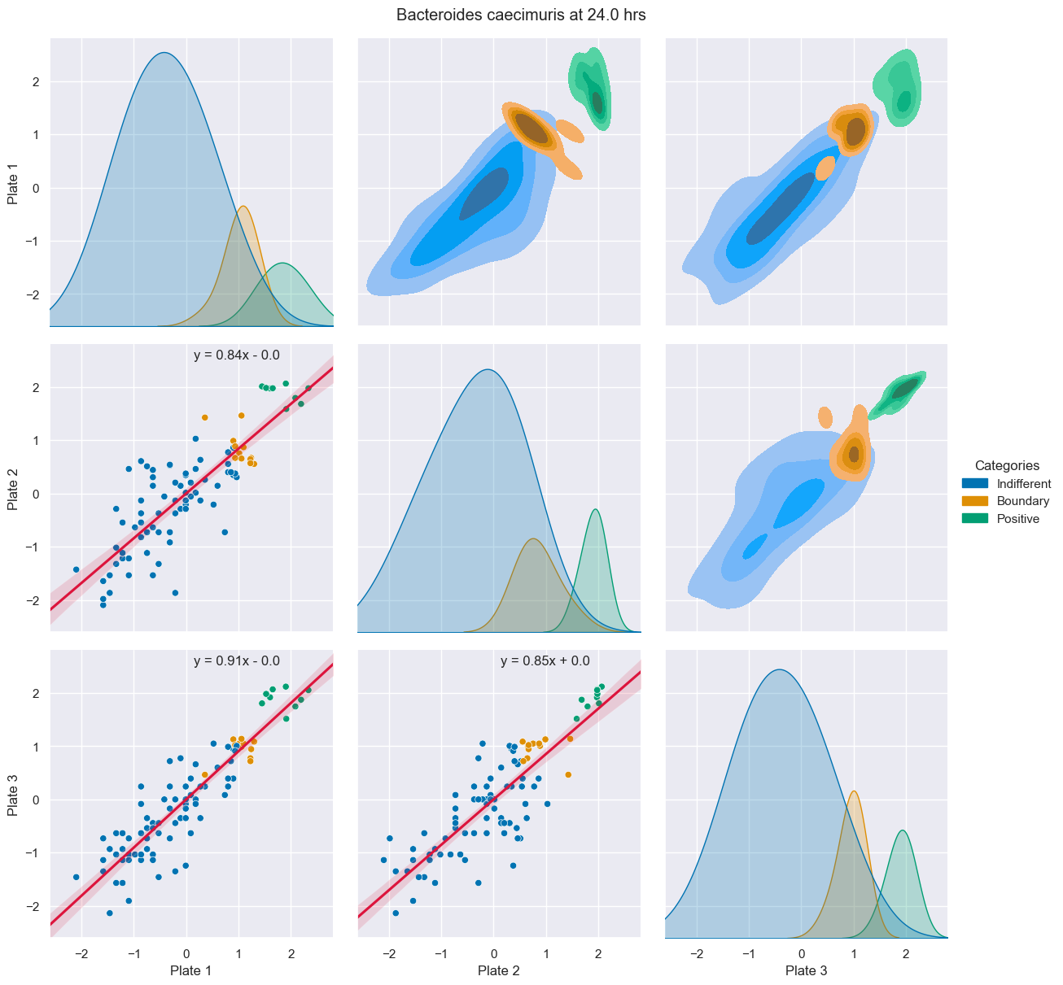
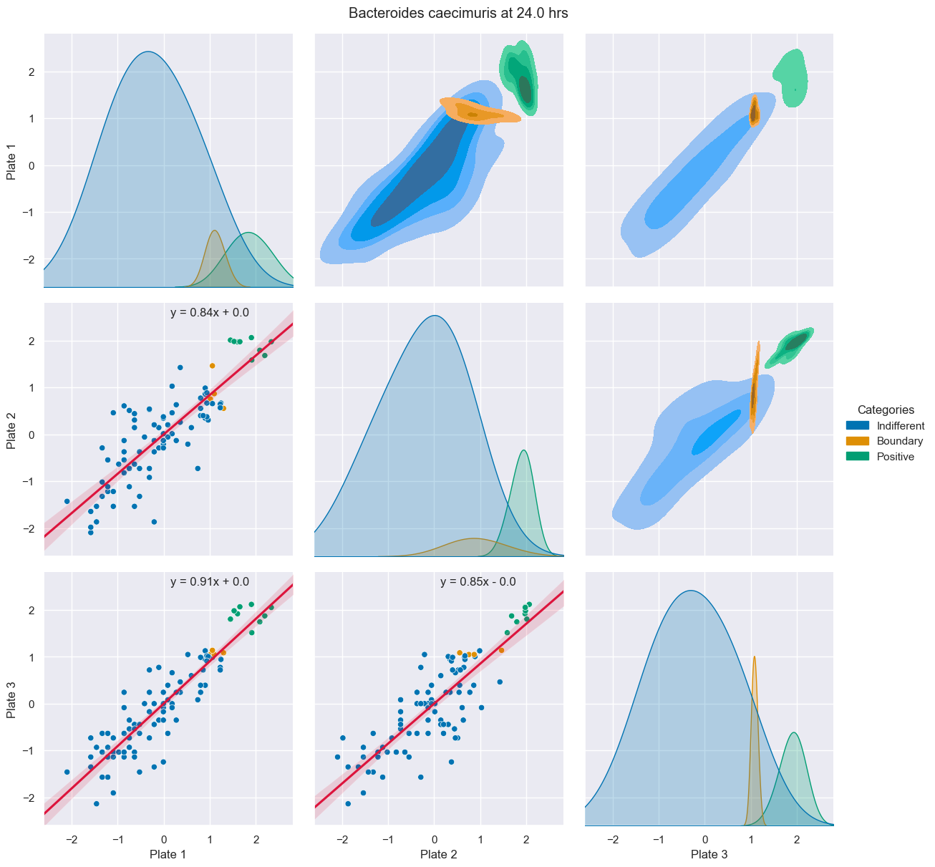
23-32 BWA Normalized
BIOLOG
BNT

Slide 12
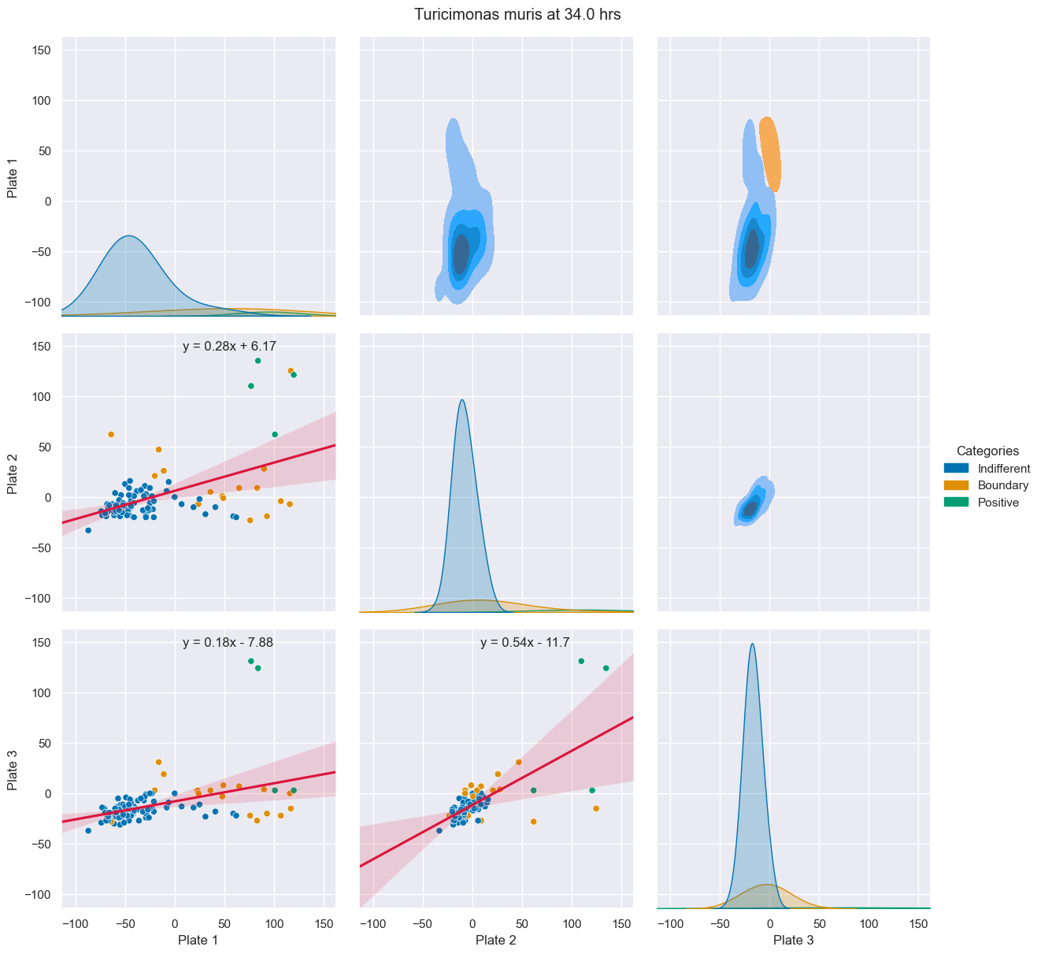
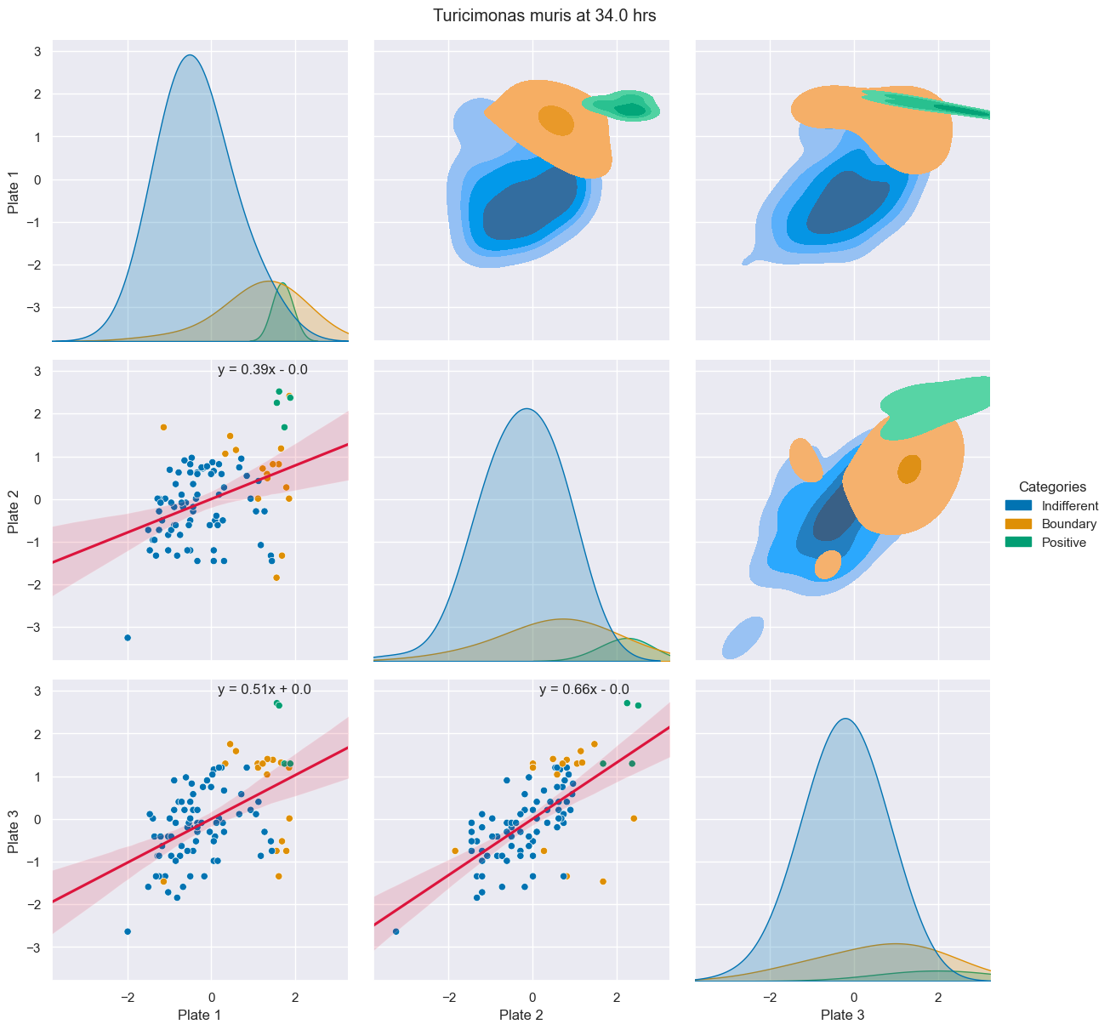
23-41 Case Study
Raw
Normalized
Notes:
Plate 1 negative control (Water) strongly differs from the other plates. Negative controls don't change significantly throughout the timepoints
Plate 1 presents generally higher values, but this is not consistent for all points → High variability between values
Data was correctly captured

Slide 13
General Notes
Possible unsuccessful cultivations:
23 – 41 Turicimonas muris
23 – 46 Flintibacter butyricus
For several strains, normalizing BWA but categorizing with the original BIOLOG categorization worked.
Possible solution for high normalized scatter, resulting categorization and linear regression model plot’s slope may be identifying and discriminating outliers. Mostly observed in strains with differing Plates.
Long, thin, right tailed data sets (few high positive values) suffer from a high scatter when normalized.
Negative controls have a (previously undervalued) impact on the resulting distribution and thus, categorization of data.

Slide 14
General Notes
At this point, still not able to determine if BIOLOG alone is suitable to identify possible metabolic candidates. Required next steps:
Cultivation experiments
HPLC
Consistent negative controls
Compare to 590 nm Pair Grids

Slide 15
Metabolite List
Simple Sugars
D-Fructose
D-Glucose
D-Galactose
D-Lactose
D-Galacturonic Acid
D-Mannose
3-Methyl-D-Glucose
Palatinose
L-Rhamnose
Turanose
...
Complex Sugars
Dextrin
Glycose

Slide 16
Metabolite List
Avoid for now
Singular amino-acids
Nucleotides
Acids

